Slide 1

Scalable Tucker Factorization for Sparse Tensors - Algorithms and Discoveries
Sejoon Oh
Data Mining Lab
Dept. of CSE
Seoul National University

Slide 2
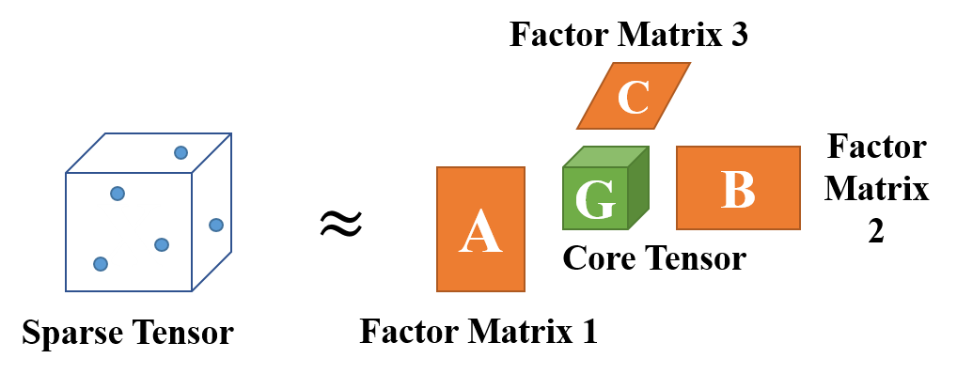
Overview
Q: Given sparse multi-dimensional data, how can we discover latent concepts/relations and predict missing values?
A: Our proposed method P-Tucker, a scalable Tucker factorization method for sparse tensors

Slide 3
Outline
Introduction & Problem Definition
Proposed Method: P-Tucker
Experiments
Conclusion

Slide 4

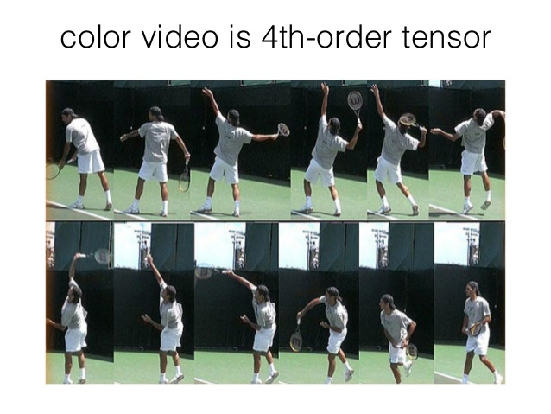

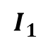
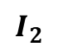
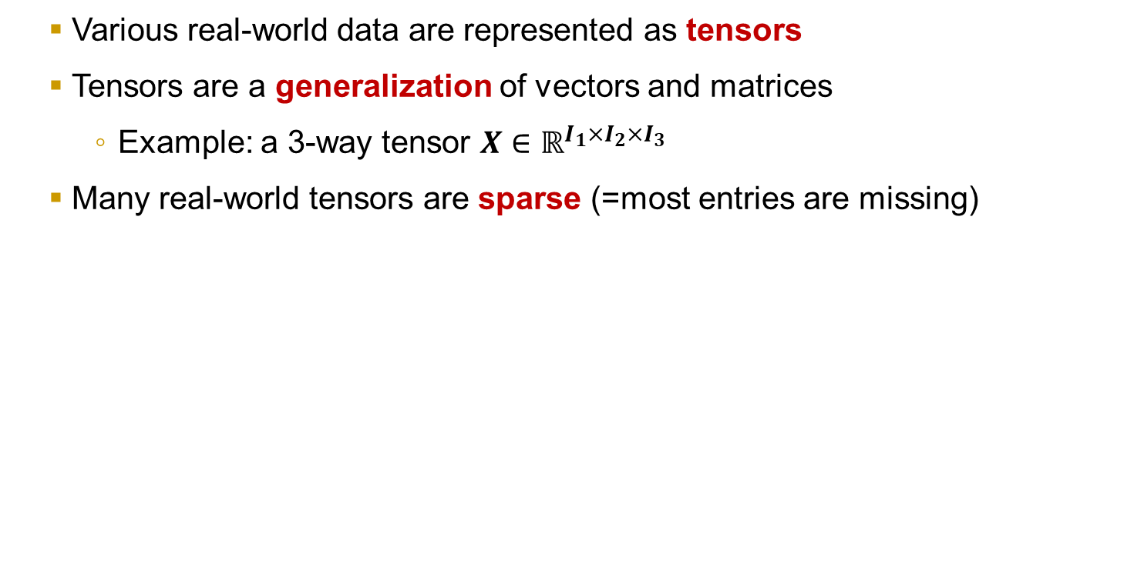
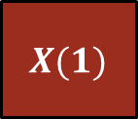
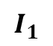
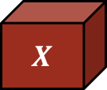
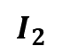
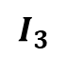
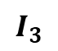
Introduction | Proposed Method | Experiment | Conclusion
Motivation – What are tensors?
$$I_{3}$$
Various real-world data are represented as tensors
Tensors are a generalization of vectors and matrices
Example: a 3-way tensor $X∈ℝ^{I_{1}×I_{2}×I_{3}}$
Many real-world tensors are sparse (=most entries are missing)
$$I_{3}$$
$$X$$
$$X(1)$$
$$I_{2}$$
$$I_{2}$$
$$I_{1}$$
$$I_{1}$$
Movie rating
3-way tensor Index: (user, movie, time)
Value: rating
Social network
3-way tensor Index: (user1, user2, date)
Value: friendship (binary)
Color video
4-way tensor Index: (row, column, RGB, time)
Value: 0~255

Slide 5
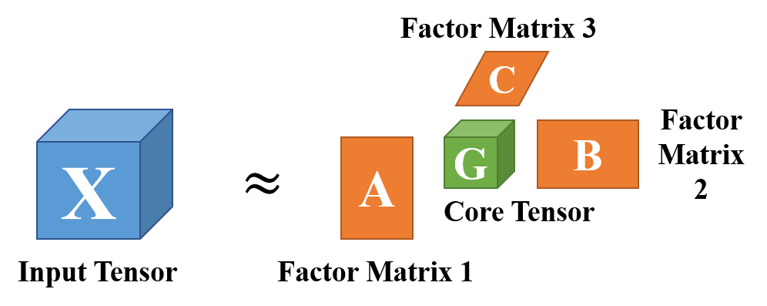
Motivation – Tensor Factorization
Introduction | Proposed Method | Experiment | Conclusion
Q: How can we extract meaningful knowledge from tensors?
A: Tensor factorization!
Two major tensor factorizations: PARAFAC and Tucker
Both approximate an input tensor by a core tensor and factor matrices
PARAFAC: diagonal core tensor <-> Tucker: full-dense core tensor
Tucker reveals notable relations between axes (e.g., user<->movie for movie rating data), while PARAFAC cannot discover them
Tucker factorization for a 3-way tensor

Slide 6
Tucker Factorization
Introduction | Proposed Method | Experiment | Conclusion
How can we interpret outcomes of Tucker factorizations?
Factor matrices are set of latent features of each axis/entity
Core tensor shows strengths of relations between “concepts”
“Students”, “Thriller”, “1990s” concepts are related by the strength “4.7”
Column C
“Thriller” concept
 |  | 8.6
Movie 1
Row R
Feature vector
of “Inception”
Movie 2
4.7
...
Movie M
Core Tensor G
Movie-related Factor Matrix

Slide 7
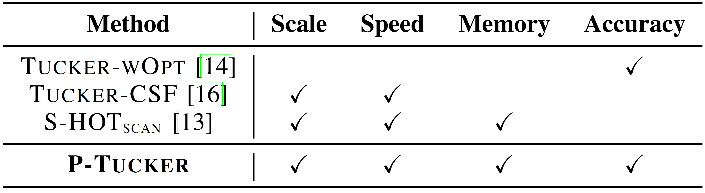
Tucker Factorization
Introduction | Proposed Method | Experiment | Conclusion
Applications of Tucker factorization
Personalized web search (Sun, J. et al., 2005)
Trend analysis in the blogosphere (Chi, Y. et al., 2006)
Content-based network analysis and visualization (Sun, J. et al., 2009)
However, there were no “appropriate” Tucker factorization methods for sparse tensors!
Existing
Tucker
Methods

Slide 8
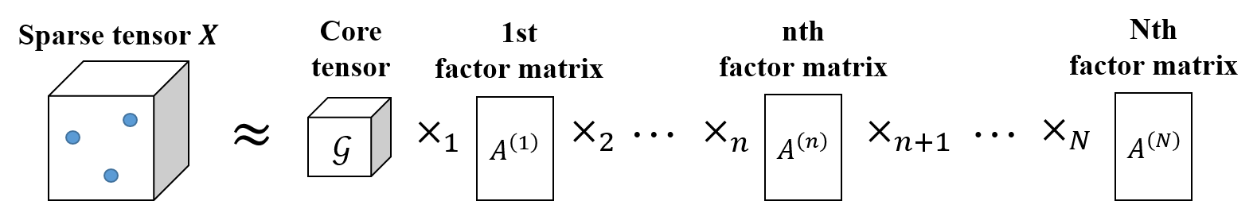
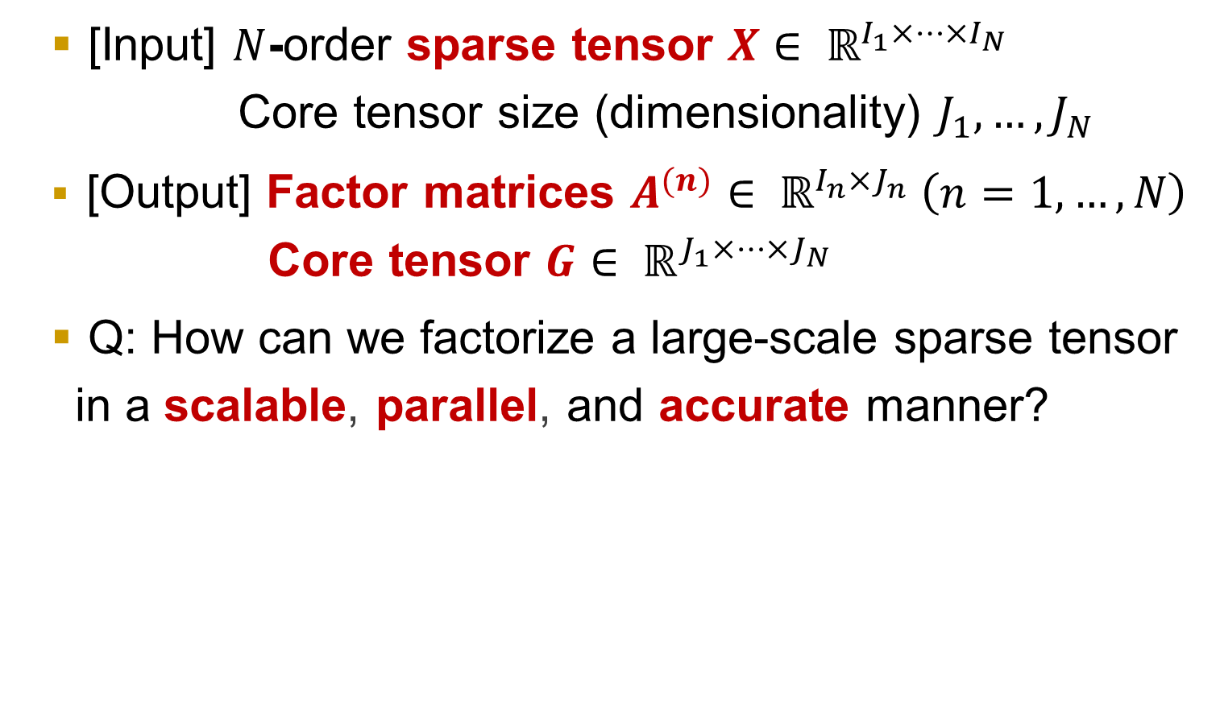
Problem Definition
Introduction | Proposed Method | Experiment | Conclusion
[Input] $N$-order sparse tensor $X∈ ℝ^{I_{1}×…×I_{N}}$ Core tensor size (dimensionality) $J_{1},…,J_{N}$
[Output] Factor matrices $A^{(n)}∈ ℝ^{I_{n}×J_{n}} \left(n=1,…,N\right)$ Core tensor $G∈ ℝ^{J_{1}×…×J_{N}}$
Q: How can we factorize a large-scale sparse tensor in a scalable, parallel, and accurate manner?

Slide 9
Outline
Introduction & Problem Definition
Proposed Method: P-Tucker
Experiments
Conclusion

Slide 10
Proposed Method - Overview
Introduction | Proposed Method | Experiment | Conclusion
We propose P-Tucker (Parallel Tucker Factorization)
A scalable and accurate TF method which utilizes a row-wise parallelization for updating factor matrices based on ALS
Main Ideas
Idea 1) We propose a row-wise update rule for factor matrices, which is a memory-efficient and accurate approach.
Idea 2) We offer multi-core parallelization which considers independence and fairness for updating factor matrices
Idea 3) We suggest two time-optimized variants of P-Tucker: P-Tucker-Cache and P-Tucker-Approx

Slide 11
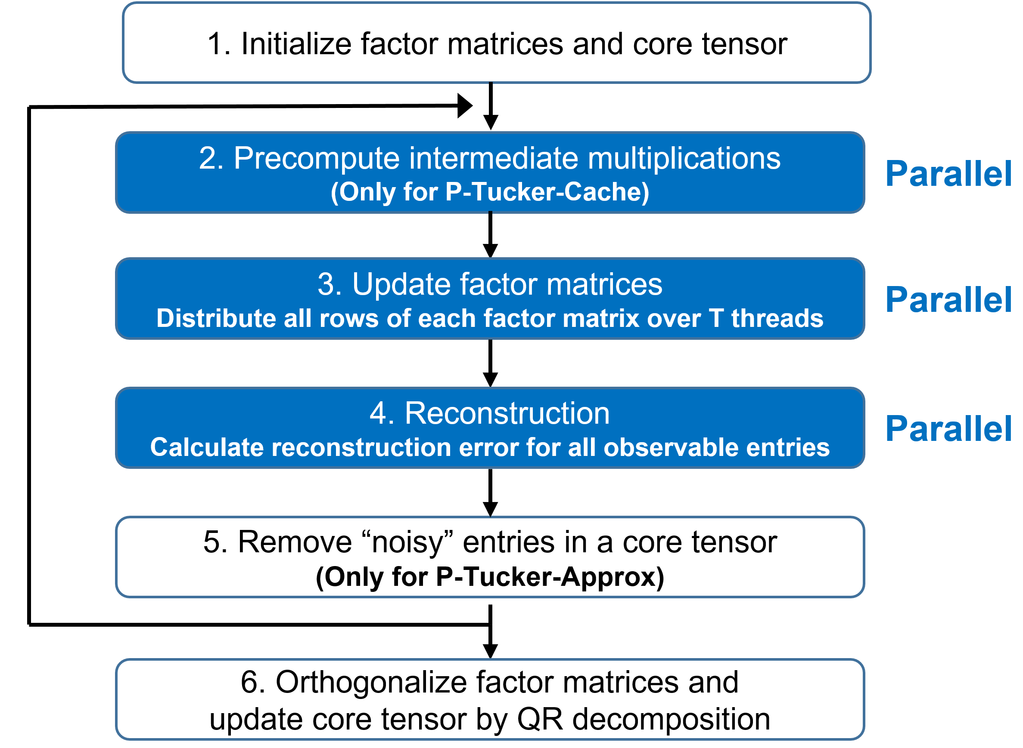
Proposed Method - Overview
Introduction | Proposed Method | Experiment | Conclusion
Notes:
This is the outline of today’s talk.

Slide 12
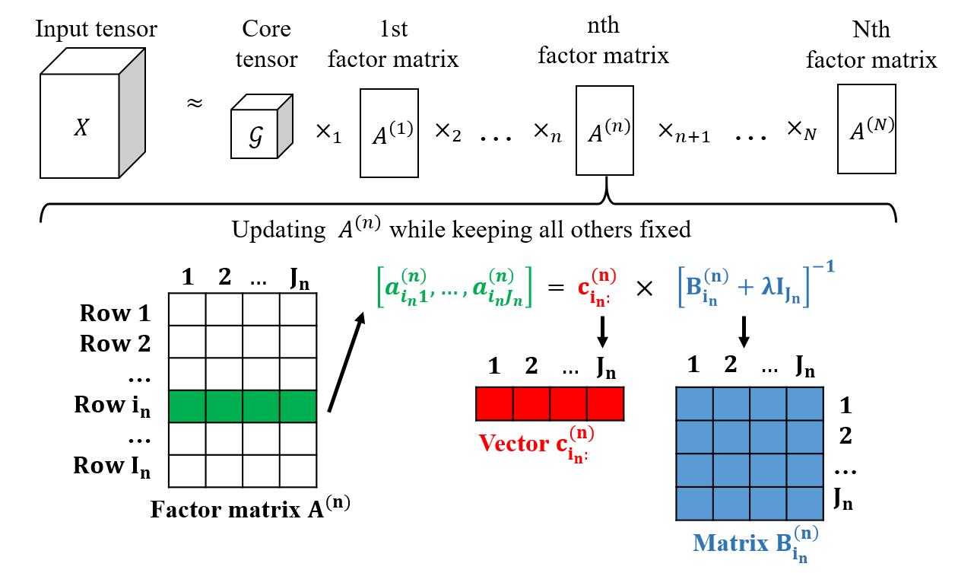
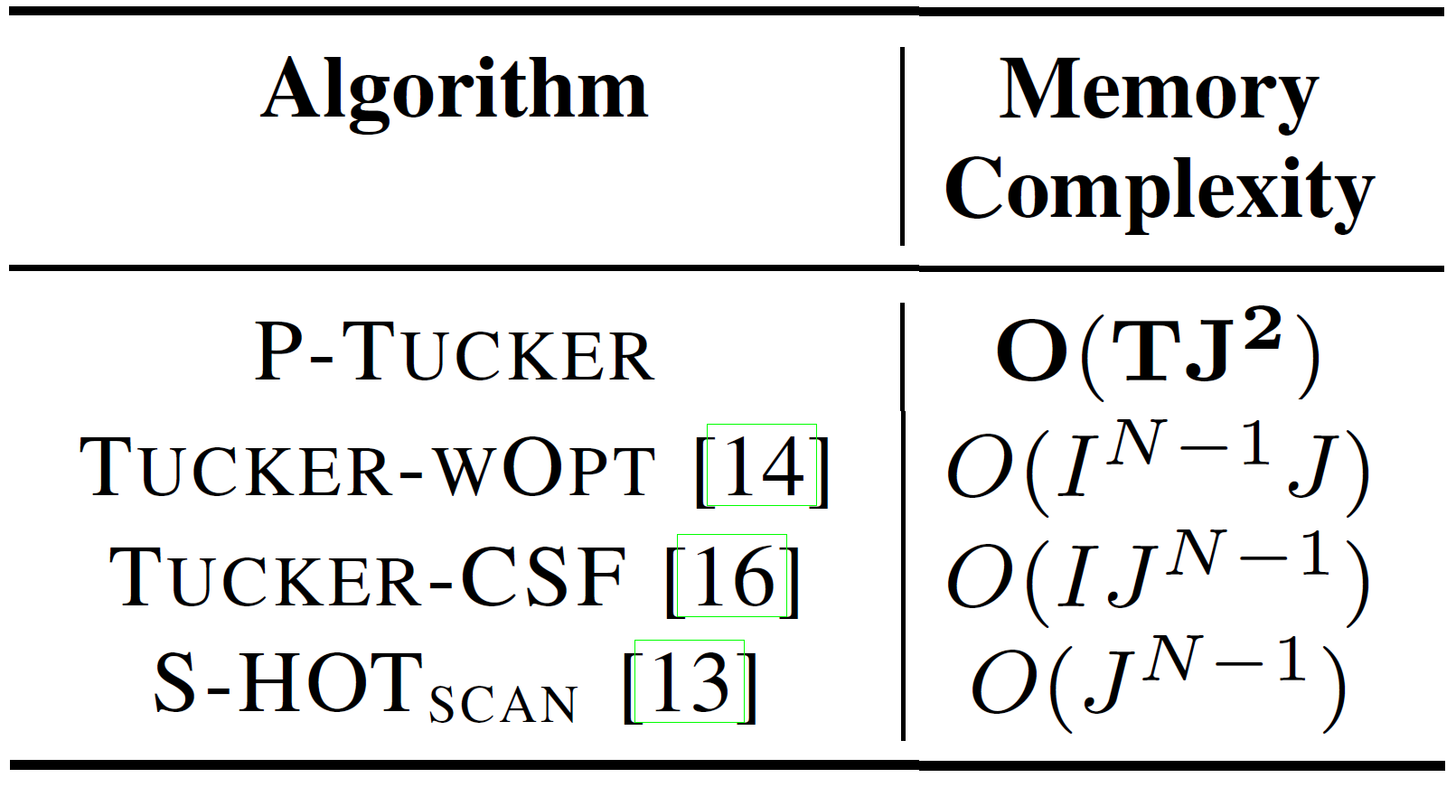
Proposed Method – Idea 1
Introduction | Proposed Method | Experiment | Conclusion
Idea 1) We propose a row-wise update rule for factor matrices, which updates a single factor matrix in a row-wise manner while fixing all the others.
Advantage 1:
Memory- efficient
Advantage 2:
Accurate
(by focusing only on observed entries)

Slide 13
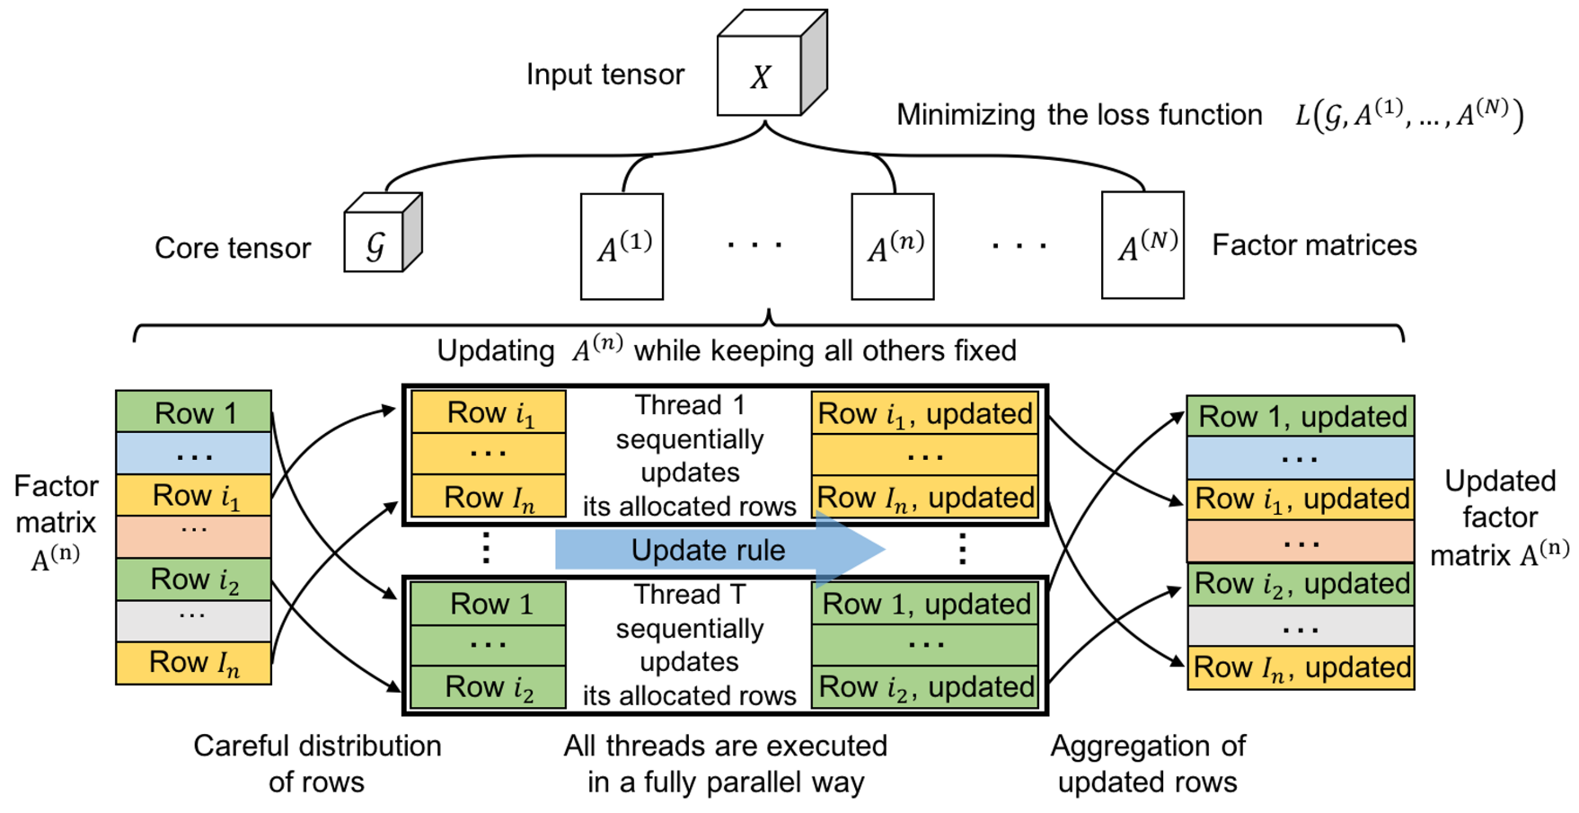
Proposed Method – Idea 2
Introduction | Proposed Method | Experiment | Conclusion
We offer multi-core parallelization with dynamic scheduling which considers workload fairness and independence between rows
Dynamic scheduling

Slide 14
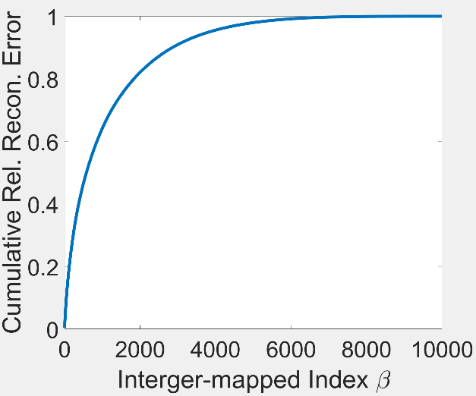
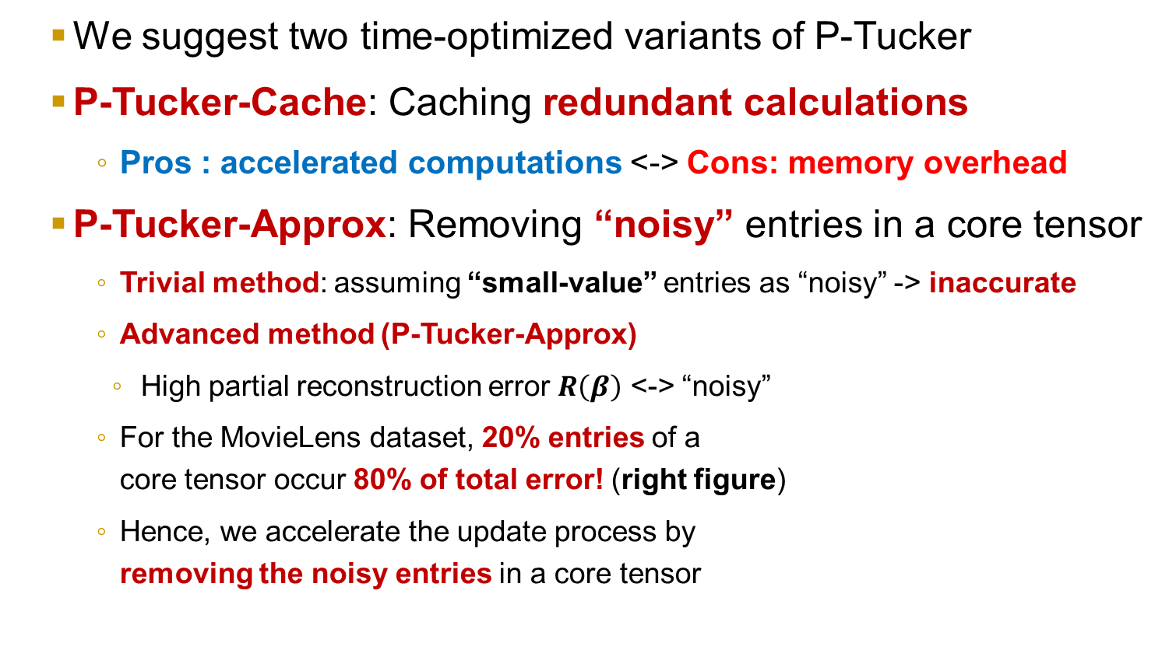
Proposed Method – Idea 3
Introduction | Proposed Method | Experiment | Conclusion
We suggest two time-optimized variants of P-Tucker
P-Tucker-Cache: Caching redundant calculations
Pros : accelerated computations <-> Cons: memory overhead
P-Tucker-Approx: Removing “noisy” entries in a core tensor
Trivial method: assuming “small-value” entries as “noisy” -> inaccurate
Advanced method (P-Tucker-Approx)
High partial reconstruction error $R\left(β\right)$ <-> “noisy”
For the MovieLens dataset, 20% entries of a core tensor occur 80% of total error! (right figure)
Hence, we accelerate the update process by removing the noisy entries in a core tensor

Slide 15
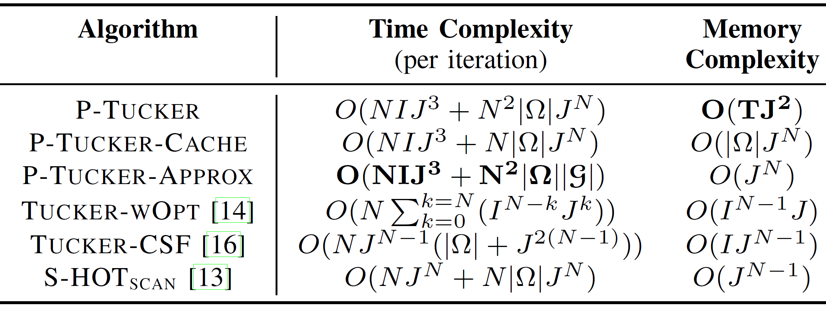
Proposed Method – Complexities
Introduction | Proposed Method | Experiment | Conclusion
P-Tucker has the best theoretical complexities among all methods!
Notes:
This is the outline of today’s talk.

Slide 16
Outline
Introduction & Problem Definition
Proposed Method: P-Tucker
Experiments
Conclusion

Slide 17
Experiment - Questions
Introduction | Proposed Method | Experiment | Conclusion
Q1. Data Scalability: How well do P-Tucker and competitors scale up with respect to the following aspects of a tensor: 1) order, 2) dimensionality, 3) number of observable entries, and 4) rank?
Q2. Effectiveness of P-Tucker-CACHE and P-Tucker-APPROX: How much do P-Tucker-CACHE and P-Tucker-APPROX accelerate the update process?
Q3. Effectiveness of Parallelization: How well does P-Tucker scale up with the number of threads used for parallelization?
Q4. Real-World Accuracy: How accurately do P-Tucker and other methods factorize real-world tensors and predict their missing entries?

Slide 18
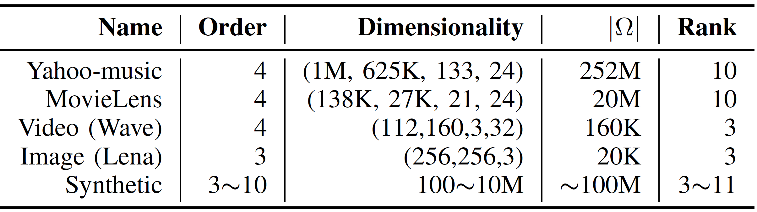
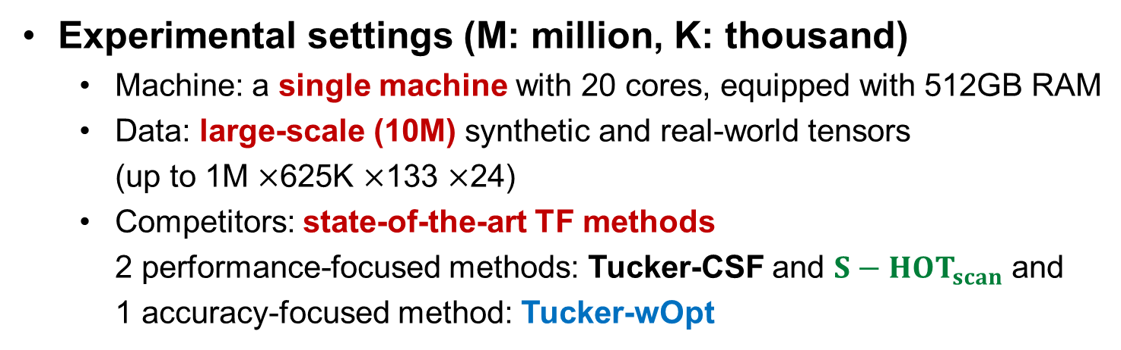
Experiment – Datasets & Settings
Introduction | Proposed Method | Experiment | Conclusion
Experimental settings (M: million, K: thousand)
Machine: a single machine with 20 cores, equipped with 512GB RAM
Data: large-scale (10M) synthetic and real-world tensors (up to 1M $×$625K $×$133 $×$24)
Competitors: state-of-the-art TF methods 2 performance-focused methods: Tucker-CSF and $S−HOT_{scan}$ and 1 accuracy-focused method: Tucker-wOpt
Notes:
This is the outline of today’s talk.

Slide 19
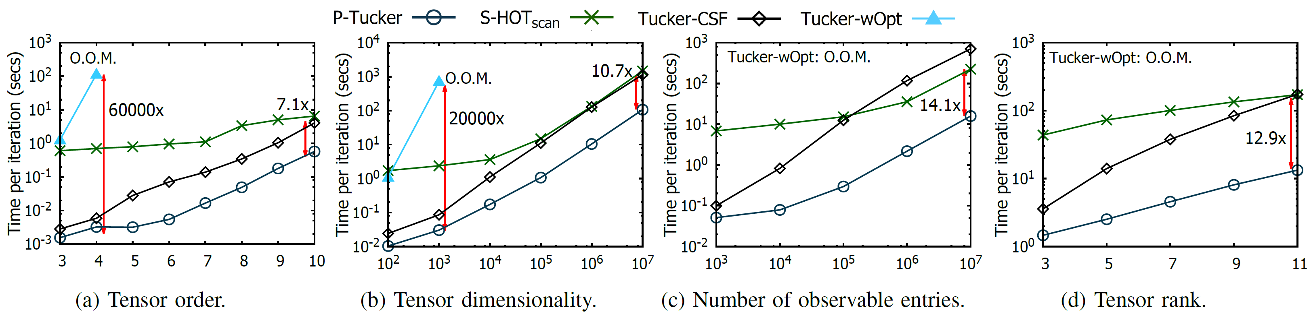
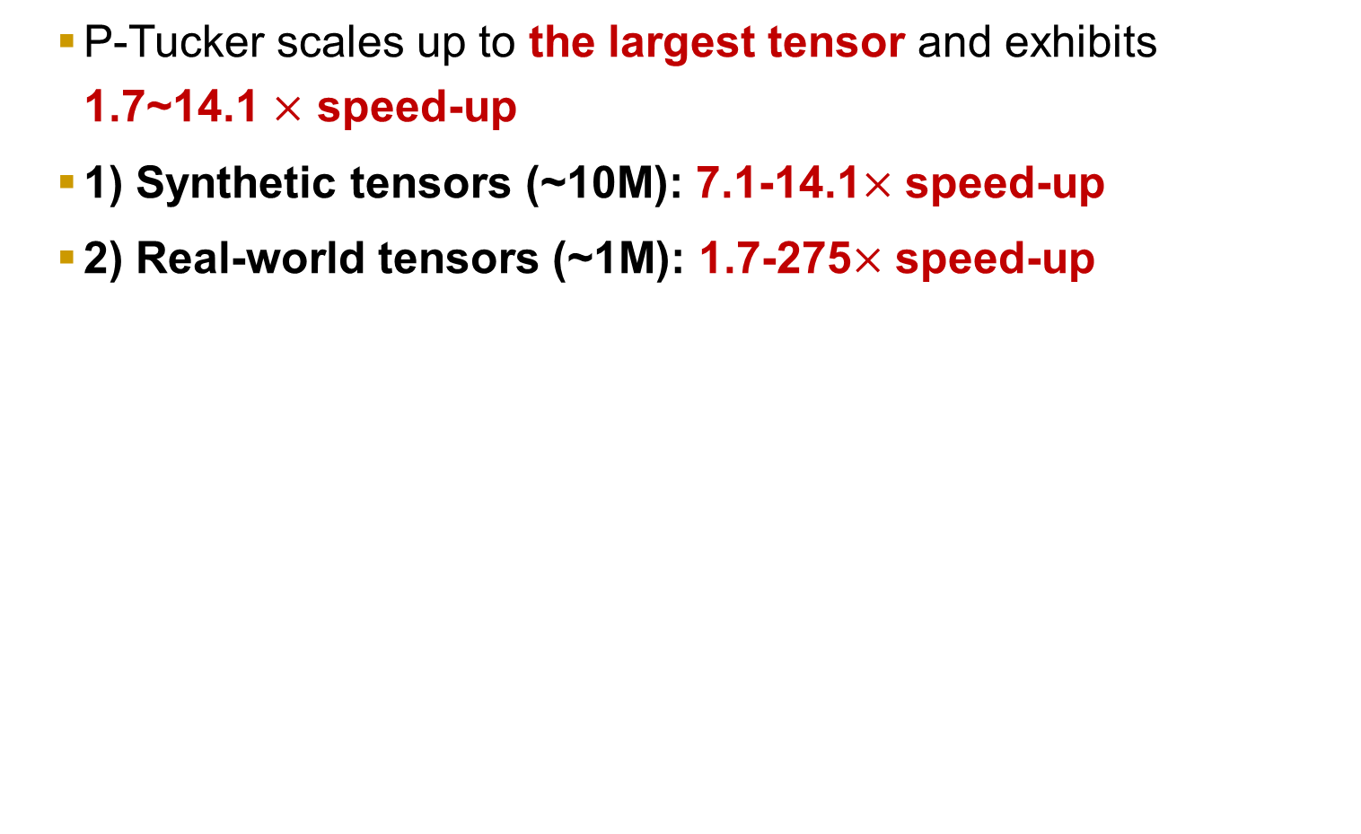
Experiment – Data Scalability
Introduction | Proposed Method | Experiment | Conclusion
P-Tucker scales up to the largest tensor and exhibits 1.7~14.1 $×$ speed-up
1) Synthetic tensors (~10M): 7.1-14.1$×$ speed-up
2) Real-world tensors (~1M): 1.7-275$×$ speed-up
Proposed Method
O.O.M. = out-of-memory

Slide 20
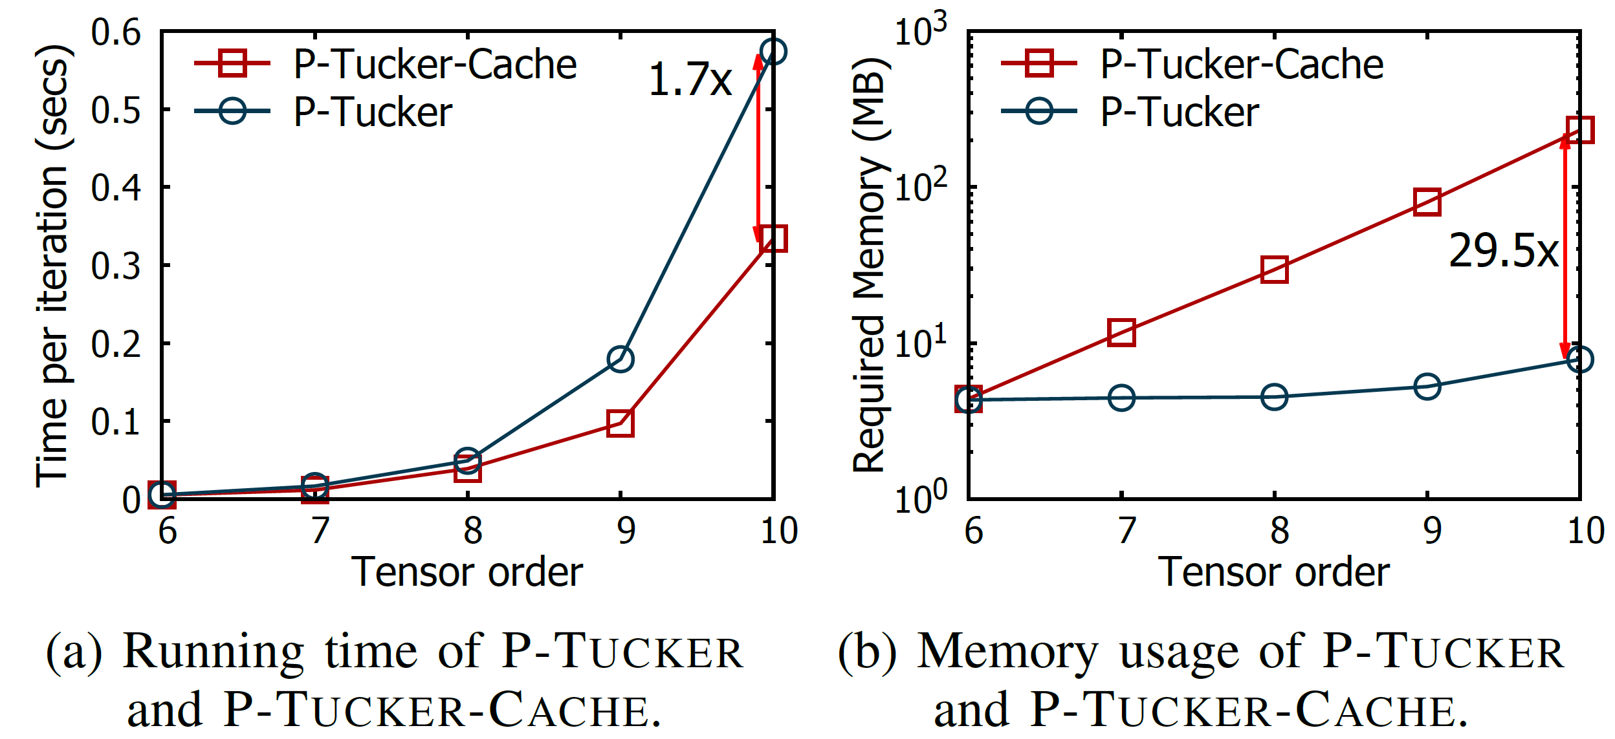
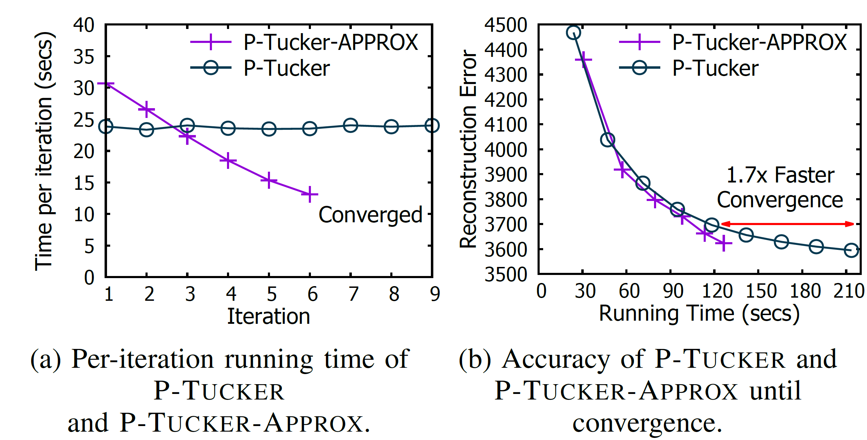
P-Tucker-Cache and P-Tucker-Approx
Introduction | Proposed Method | Experiment | Conclusion
P-Tucker-Cache shows a trade-off between time and memory
P-Tucker-Approx converges faster than P-Tucker and presents similar accuracy compared to P-Tucker
Notes:
This is the outline of today’s talk.

Slide 21
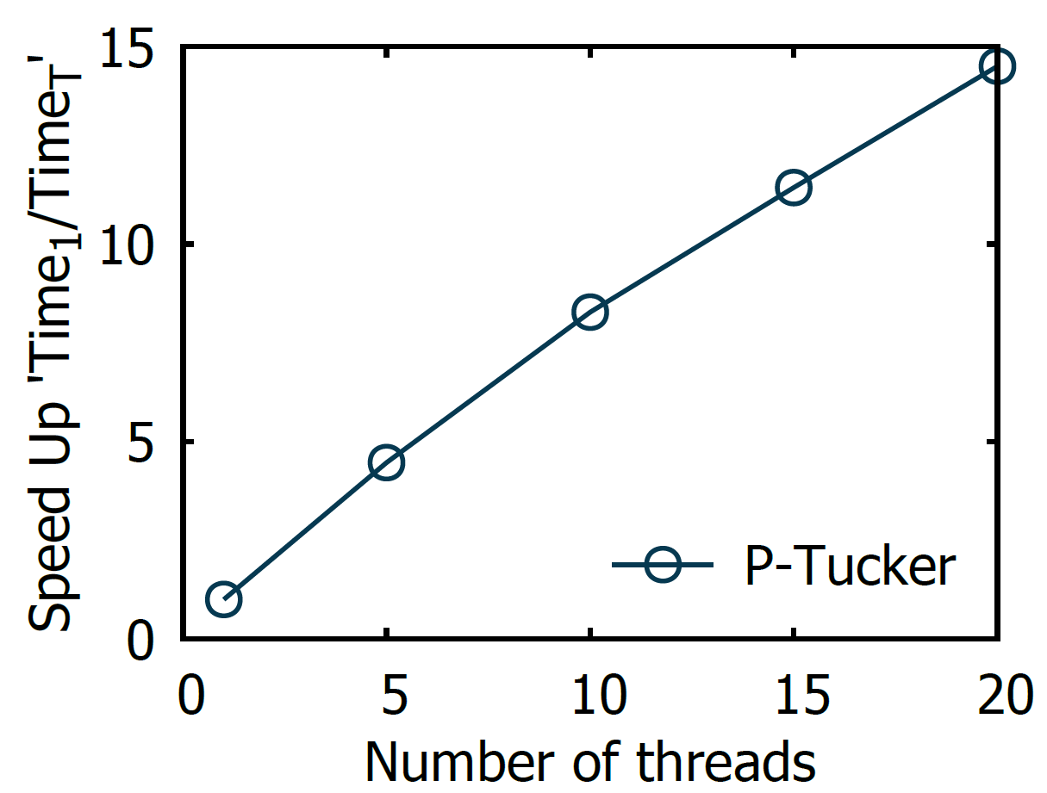
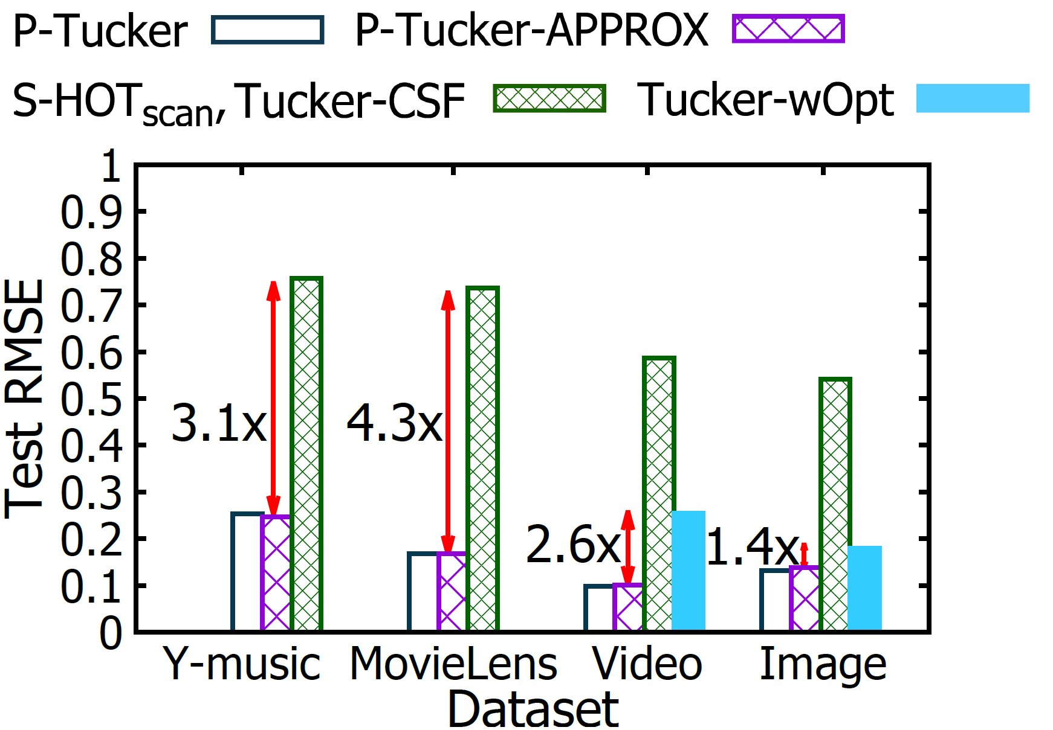
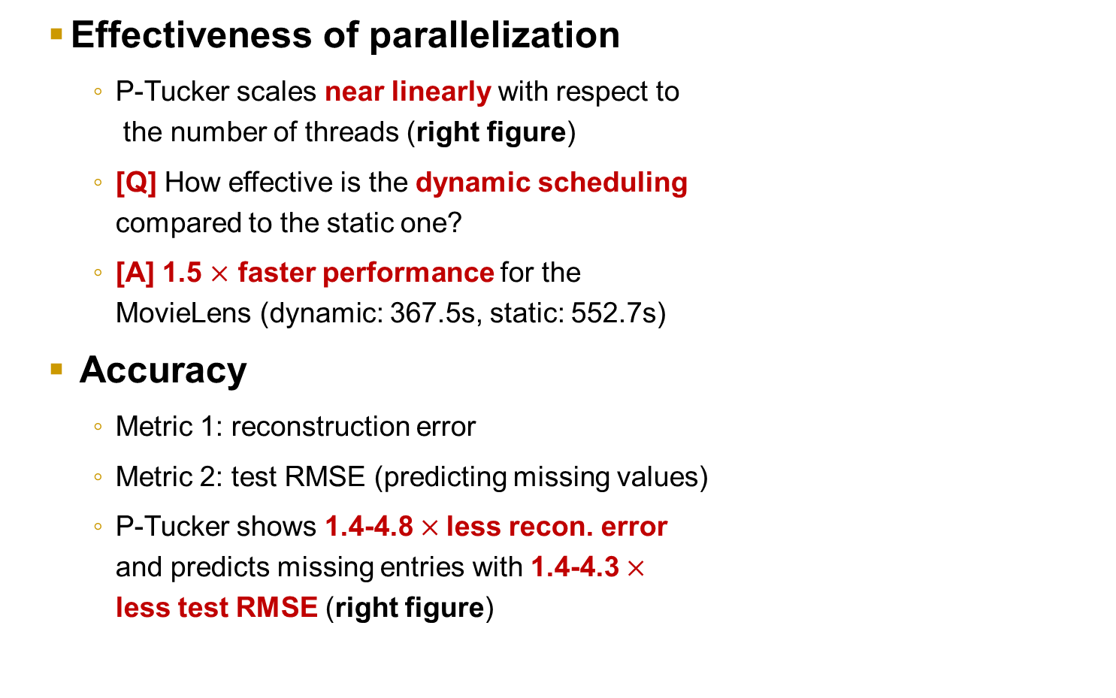
Parallelization & Accuracy
Introduction | Proposed Method | Experiment | Conclusion
Effectiveness of parallelization
P-Tucker scales near linearly with respect to the number of threads (right figure)
[Q] How effective is the dynamic scheduling compared to the static one?
[A] 1.5 $×$ faster performance for the MovieLens (dynamic: 367.5s, static: 552.7s)
Accuracy
Metric 1: reconstruction error
Metric 2: test RMSE (predicting missing values)
P-Tucker shows 1.4-4.8 $×$less recon. error and predicts missing entries with 1.4-4.3 $×$ less test RMSE (right figure)

Slide 22
Outline
Introduction & Problem Definition
Proposed Method: P-Tucker
Experiments
Conclusion

Slide 23
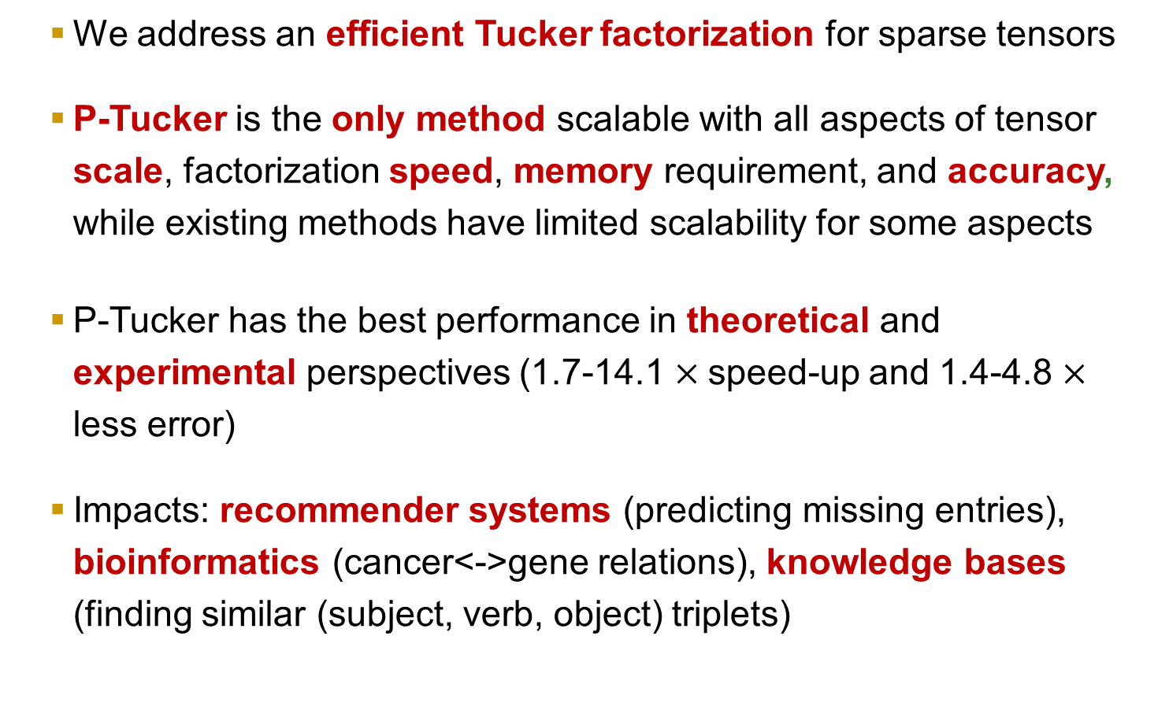
Conclusion
Introduction | Proposed Method | Experiment | Conclusion
We address an efficient Tucker factorization for sparse tensors
P-Tucker is the only method scalable with all aspects of tensor scale, factorization speed, memory requirement, and accuracy, while existing methods have limited scalability for some aspects
P-Tucker has the best performance in theoretical and experimental perspectives (1.7-14.1 $×$speed-up and 1.4-4.8 $×$ less error)
Impacts: recommender systems (predicting missing entries), bioinformatics (cancer<->gene relations), knowledge bases (finding similar (subject, verb, object) triplets)

Slide 24
Thank you !

Slide 25
Appendix - Existing Methods
Introduction | Proposed Method | Experiment | Conclusion
Alternating Least Square (ALS) is widely used for Tucker
Given many parameters, updates a parameter while fixing all the others
Based on ALS, various TF algorithms have been developed
Fully Observable TF Methods
Definition: TF methods which regard missing entries of a tensor as zeros
(+) High scalability
(+) Easily parallelizable
(-) Low accuracy
Partially Observable TF Methods
Definition: TF methods which ignore missing entries of a tensor
(+) High accuracy
(-) Limited scalability
(-) Not easy to parallelize

Slide 26
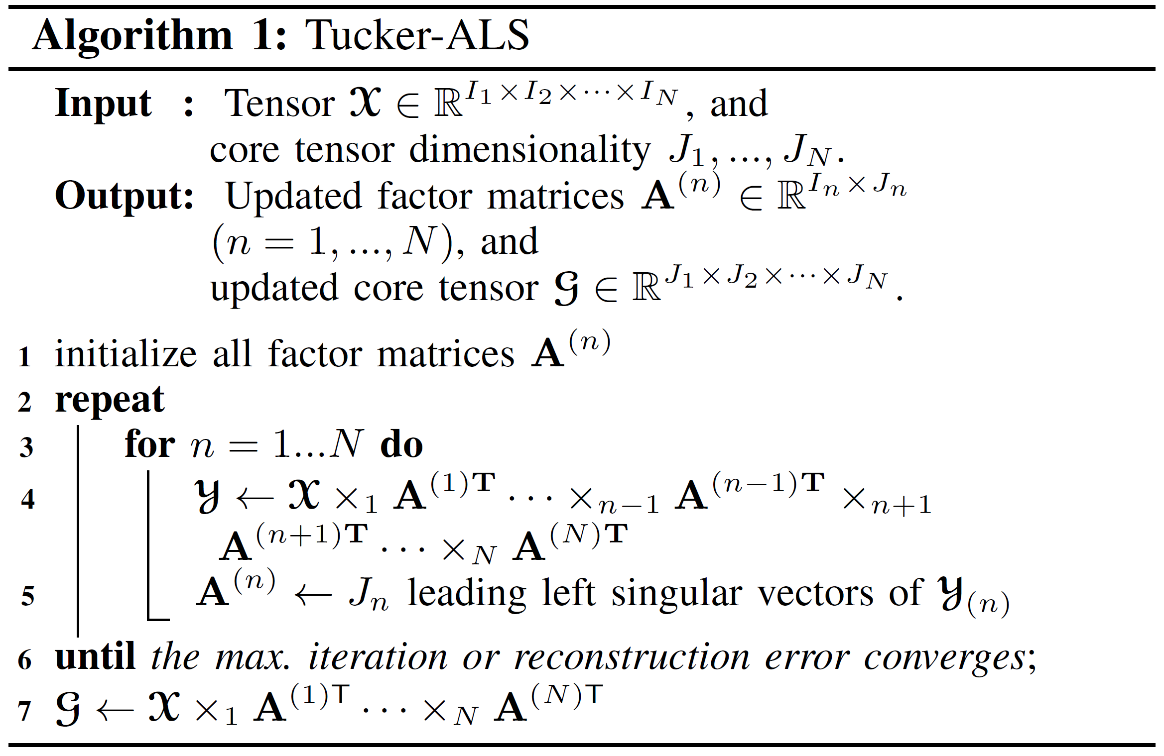

Higher-order Orthogonal Iteration (HOOI)
Introduction | Proposed Method | Experiment | Conclusion
Causing intermediate data explosion
Most TF methods are based on Higher-order Orthogonal Iteration
HOOI suffers from intermediate data explosion while computing $Y$
HOOI regards missing entries as zeros, which causes low accuracy
Notes:
This is the outline of today’s talk.

Slide 27
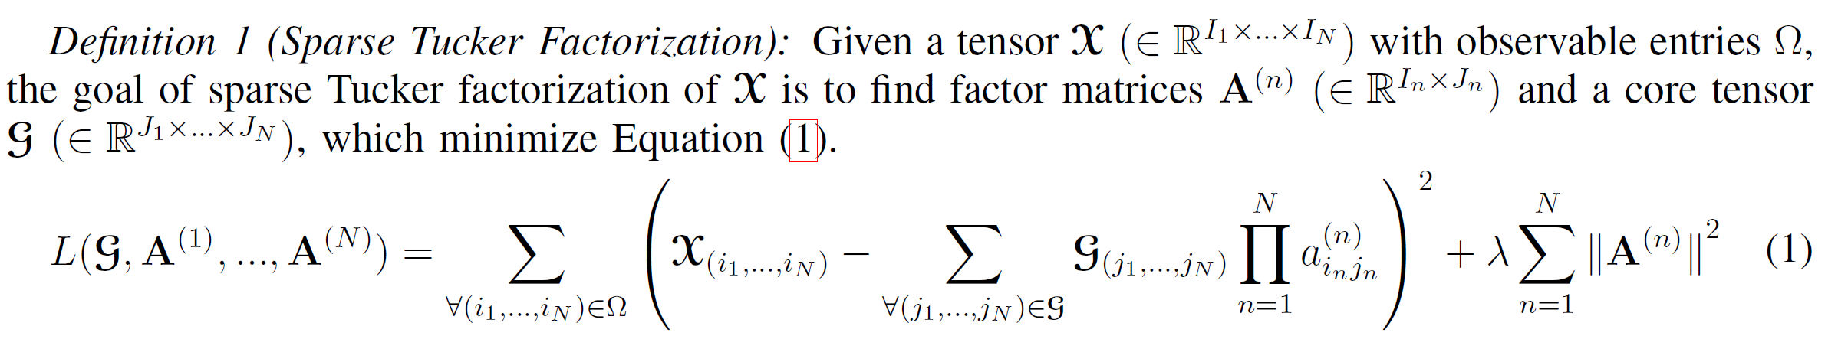
Appendix - Loss Function
Introduction | Proposed Method | Experiment | Conclusion
Only observed entries
L2 regularization
The loss function only depends on observed entries of X
L2 regularization is used in the loss function to prevent overfitting, which has been generally utilized in machine learning problems
Notes:
This is the outline of today’s talk.

Slide 28
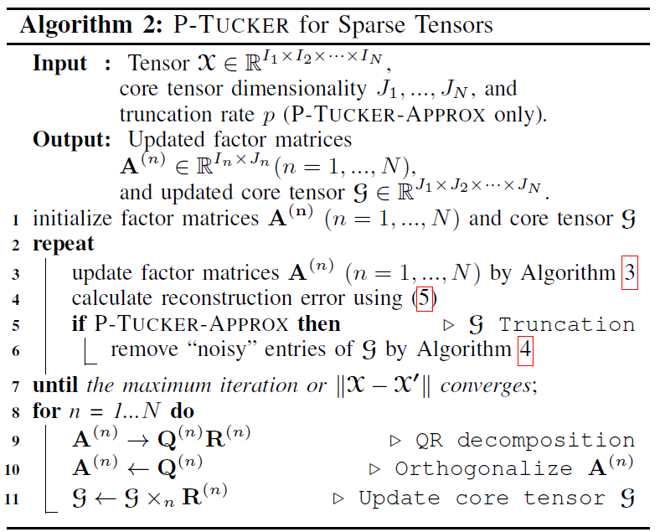
Appendix – P-Tucker Algorithm
Introduction | Proposed Method | Experiment | Conclusion
Notes:
This is the outline of today’s talk.

Slide 29
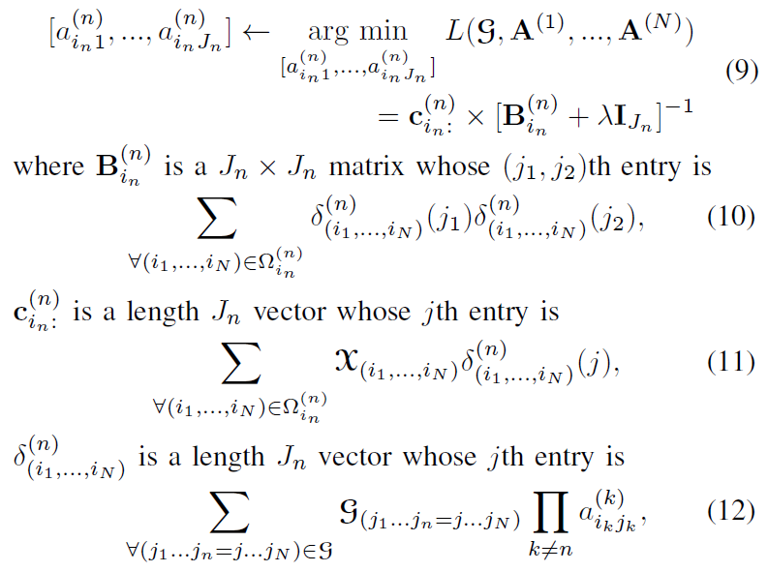
Appendix – Row-wise Update Rule
Introduction | Proposed Method | Experiment | Conclusion
Notes:
This is the outline of today’s talk.

Slide 30
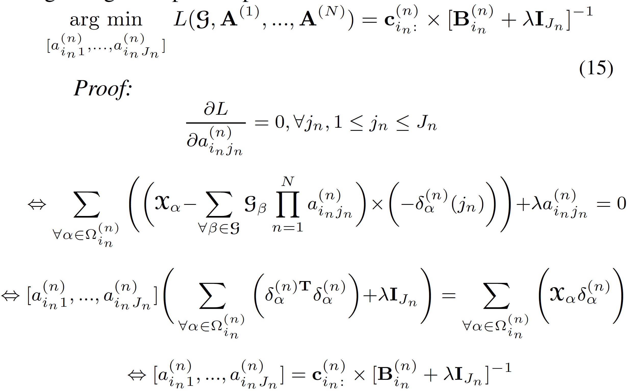
Proof of row-wise updates
Introduction | Proposed Method | Experiment | Conclusion
Note that the full proof of row-wise updates is summarized in the supplementary material
Notes:
This is the outline of today’s talk.

Slide 31
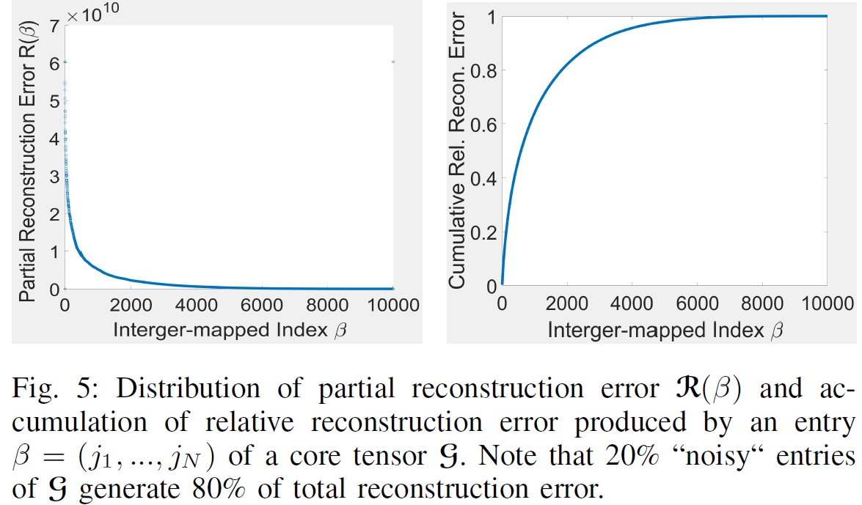
Appendix – Intuition of P-Tucker-Approx
Introduction | Proposed Method | Experiment | Conclusion
Notes:
This is the outline of today’s talk.

Slide 32
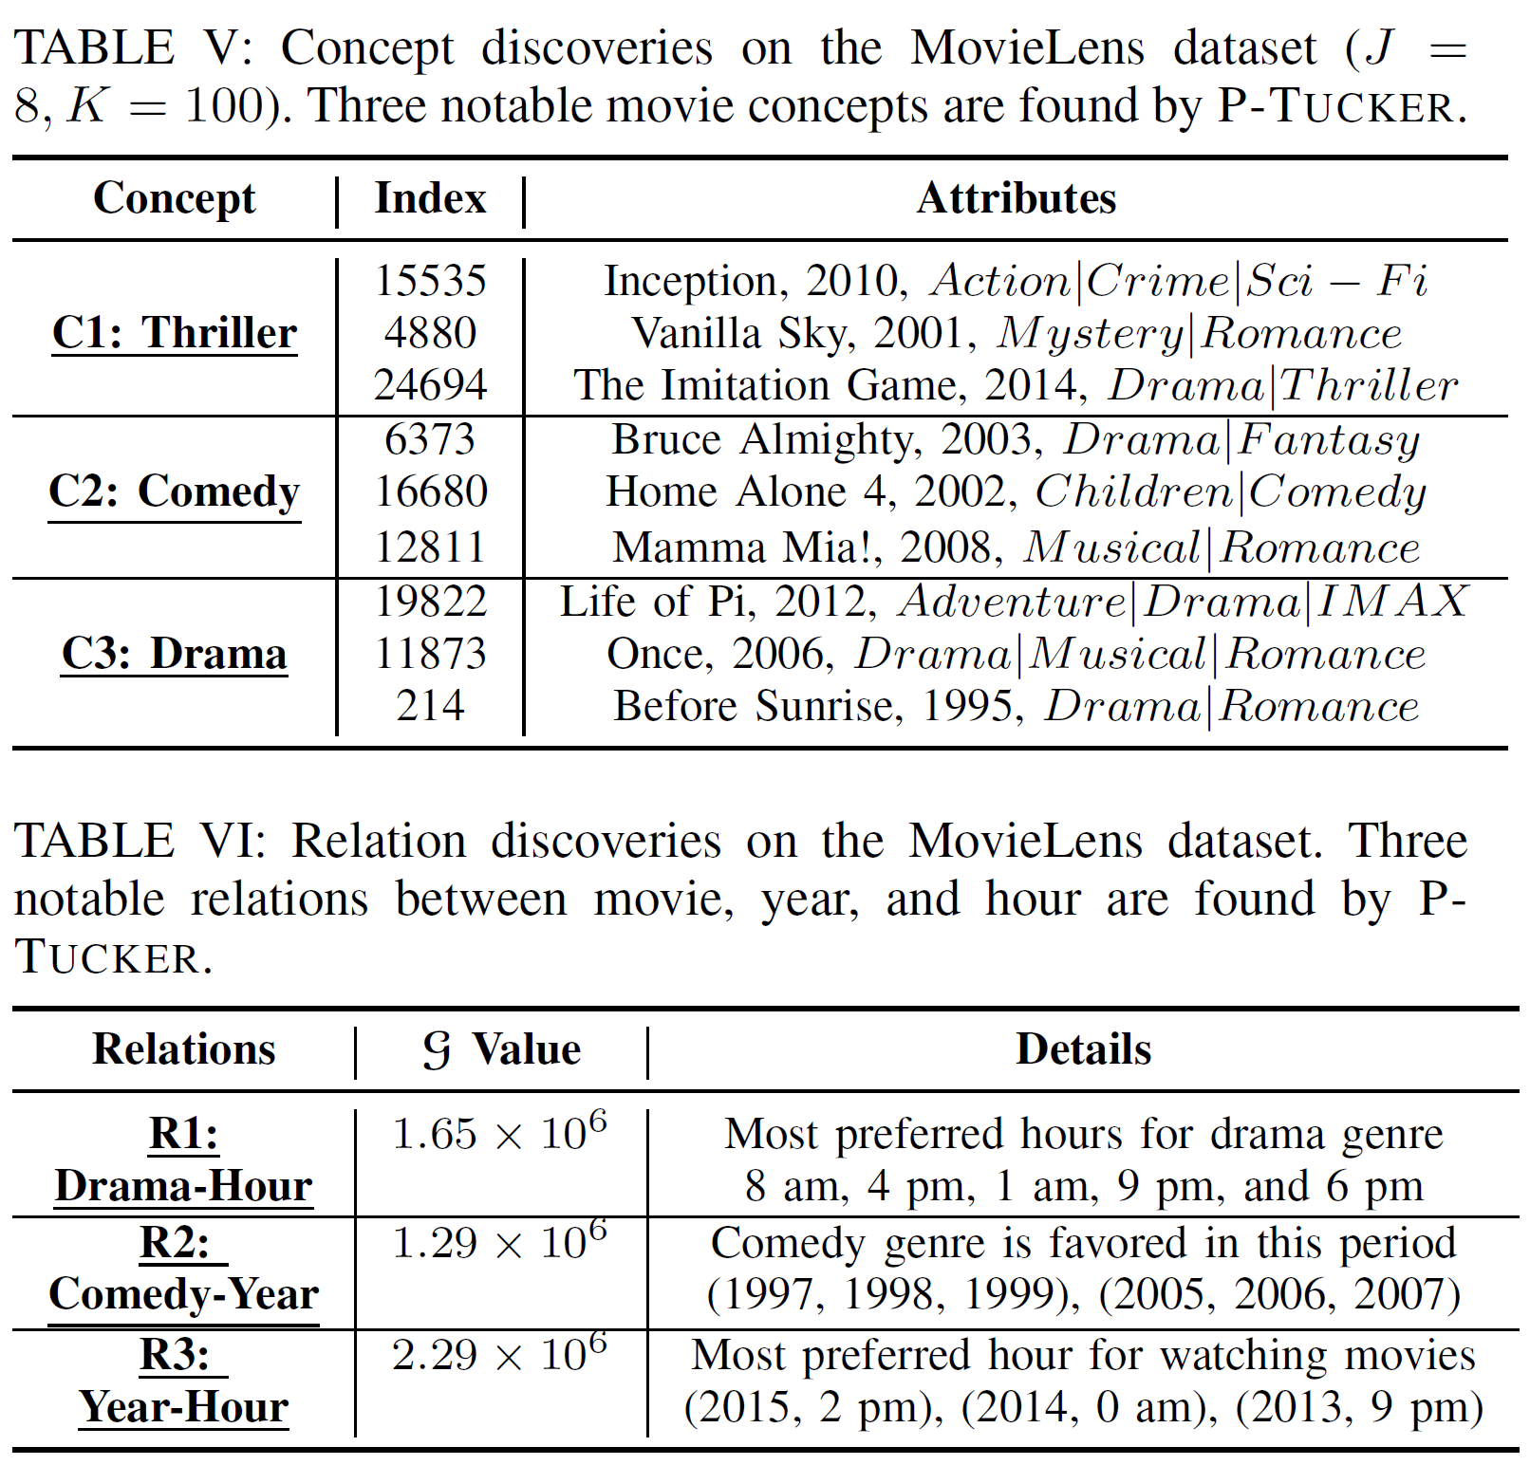
Appendix - Real-World Applications
Introduction | Proposed Method | Experiment | Conclusion
1. Concept discovery: Three notable concepts are found by P-Tucker
(e.g., Thriller concept)
2. Relation discovery:
We found interesting relations between movie, year, and hour using P-Tucker
Notes:
This is the outline of today’s talk.

Slide 33
Appendix – References
Introduction | Proposed Method | Experiment | Conclusion
1. J.-T. Sun, H.-J. Zeng, H. Liu, Y. Lu, and Z. Chen, “Cubesvd: A novel approach to personalized web search,” in WWW, 2005, pp. 382–390.
2. Y. Chi, B. L. Tseng, and J. Tatemura, “Eigen-trend: trend analysis in the blogosphere based on singular value decompositions,” in CIKM, 2006, pp. 68–77.
3. J. Sun, S. Papadimitriou, C.-Y. Lin, N. Cao, S. Liu, and W. Qian, “Multivis: Content-based social network exploration through multi-way visual analysis,” in SDM, 2009, pp. 1064–1075.
4. S. Smith and G. Karypis, “Accelerating the tucker decomposition with compressed sparse tensors,” in Europar, 2017.
5. J. Oh, K. Shin, E. E. Papalexakis, C. Faloutsos, and H. Yu, “S-hot: Scalable high-order tucker decomposition,” in WSDM, 2017.
6. M. Filipovic and A. Jukic, “Tucker factorization with missing data with application to low-n-rank tensor completion,” Multidimensional systems and signal processing, vol. 26, no. 3, pp. 677–692, 2015.
Notes:
This is the outline of today’s talk.

